Slide 1

Green World!

Slide 2







The Problem
Industrial Impact
Changing Climate
Food Waste
Soil Infertility
Power Scarcity
Inadequate supply of raw cassava for industrial cassava processing due to the problem of how to produce beyond domestic demand and sustain supply to the international markets
Global warming caused by environmental pollution and greenhouse gas emission is one alarming problem of Nigeria and the world at large
High cost of chemical fertilizers and wrong farming practices like continuous cropping, stubble burning and indiscriminate felling of trees, causes reduced crop yield, soil infertility, soil erosion, depletion of soil nutrients, climate change
In Nigeria, biodegradable waste is the 3rd largest waste stream. Giving rise to many hygiene related illnesses like Cholera, Diarrhea, Malaria and more.
Traditional method of agriculture due to power scarcity and high cost of petroleum products in most local areas, limits mechanized food processing

Slide 3
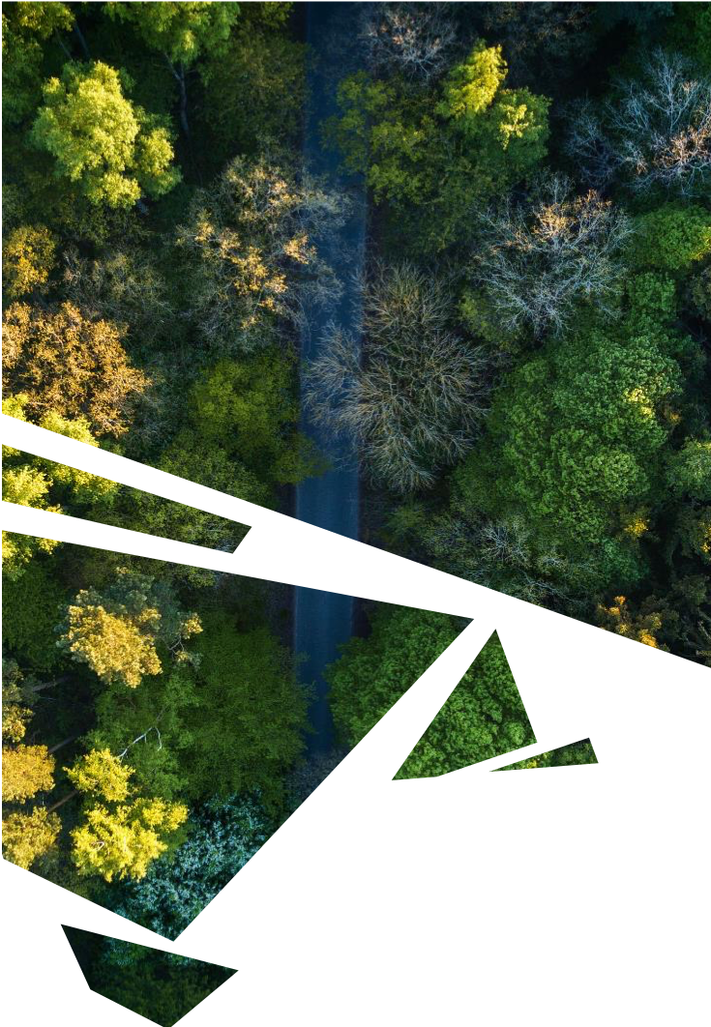





The Solution
Affordable and Clean Energy
Food Security
Cassava Industrialization
There is need to avoid waste of productive resources i.e cassava and other food waste and protect the environment while exploring the soil for sufficient food production with a view to ultimately achieving zero hunger, sustainable cities and communities
To ensure climate security and steady supply of power, an alternative source of renewable energy for cooking and processing agro-products, is highly recommended
Connecting cassava farmers to food processing companies for profit-making and Industrialization of cassava

Slide 4
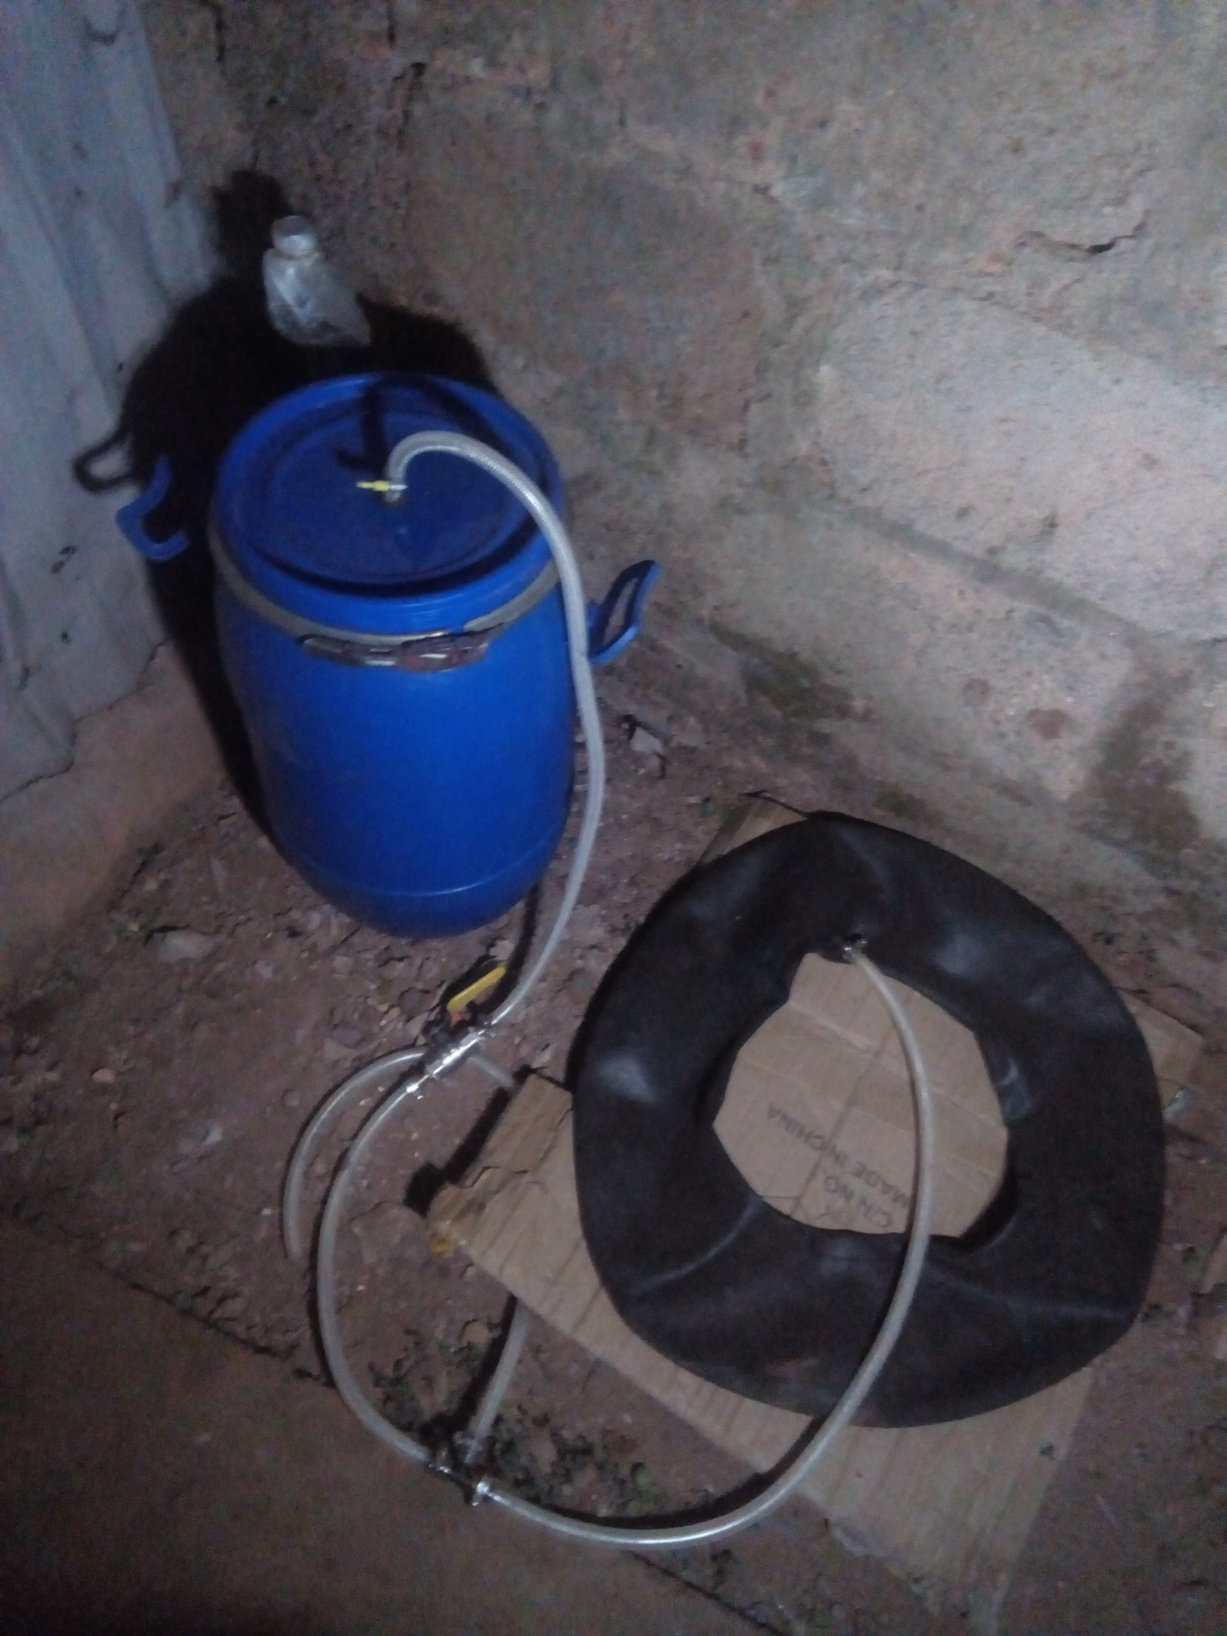


The Product
Bio-Recyclers
converts the food waste(cassava and household waste) through anaerobic digestion into biogas for cooking and food processing.
Bio-Gas
for cooking, and as bio-fuel for powering gas engines and electricity for food processing
Bio-Fertilizers
for improving crop yield and soil fertility

Slide 5
Digital Product
Trine App
to serve as an intermediary between farmers, food processing companies and the final consumer
Other benefits include
Online tutor on installation and maintenance services
Online…

Slide 6



Business Model
There is an opportunity for success
Fortify
De-Marginalize
Research

Slide 7
Competition
Our Company
Competitor
Eco-friendly and Recyclable (Products and Process of production).
Sufficient supply of raw materials (the biodegradable waste) needed for our bio-recycler to produce the bio-gas with little or no cost added both financially and environmentally
The by-product of our bio-recycler (the bio-fertilizer), is a very rich nutrient organic fertilizer that is readily available for the plants to absorb without any health effects like chemical fertilizers.

Slide 8
Growth Strategy
How will we scale in the future
Phase 1 Month, Year
Phase 2 Month, Year
Phase 3 Month, Year

Slide 9


TEAM
MMERICHUKWU NNAEBUKA ANOSIKE
CO-FOUNDER
GLORY UCHECHUKWU AMADIFE
CO-FOUNDER

Slide 10




Thank You
TRINE TECH
+2348064501332
+2348110671481
TRINETECHNOLOGY001@GMAIL.COM
TRINETECH.BLOGSPOT.COM

